Slide 1

CHAPTER 5:
GEOMETRIC TRANSFORMATIONS

Slide 2
GEOMETRIC TRANSFORMATIONS
Translation
Rotation
Scaling
Reflection
Shearing

Slide 3
EXAMPLE: 2D GEOMETRIC TRANSFORMATION
Modeling
Coordinates
World Coordinates

Slide 4
EXAMPLE: 2D SCALING
Modeling
Coordinates
Scale(0.3, 0.3)
World Coordinates

Slide 5
EXAMPLE: 2D ROTATION
Modeling
Coordinates
Scale(0.3, 0.3)
Rotate(-90)
World Coordinates

Slide 6
EXAMPLE: 2D TRANSLATION
Modeling
Coordinates
Scale(0.3, 0.3)
Rotate(-90)
Translate(1, 5)
World Coordinates

Slide 7






BASIC 2D TRANSFORMATIONS
Translation
Scale
Rotation

Slide 8
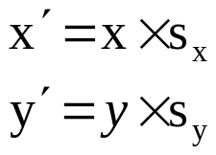
BASIC 2D TRANSFORMATIONS
  Transformations can be combined (with simple algebra)
Scale
Rotation

Slide 9
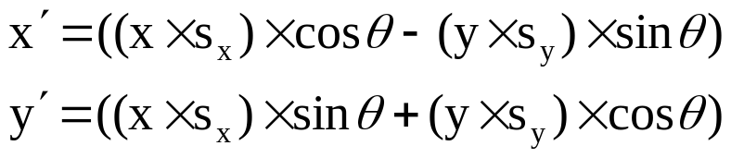
BASIC 2D TRANSFORMATIONS
Scale
Rotation

Slide 10
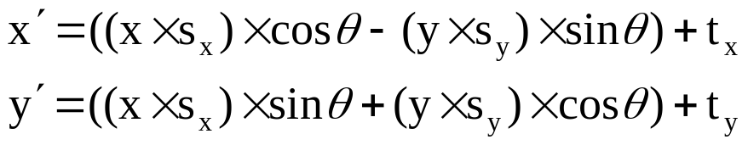
BASIC 2D TRANSFORMATIONS
Scale
Rotation
Translation

Slide 11
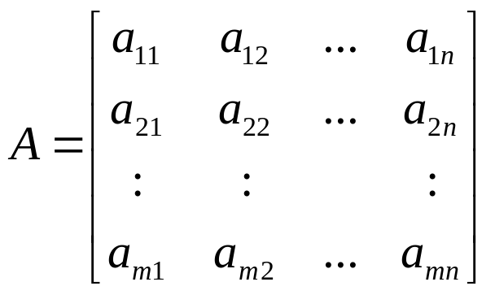
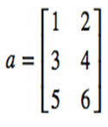
MATRICES
  Definition
    A rectangular array of quantities
  e.g.,

Slide 12
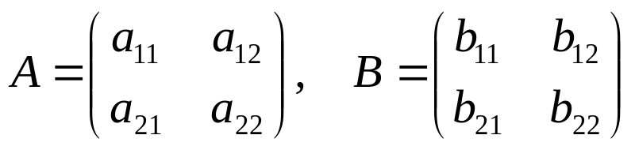
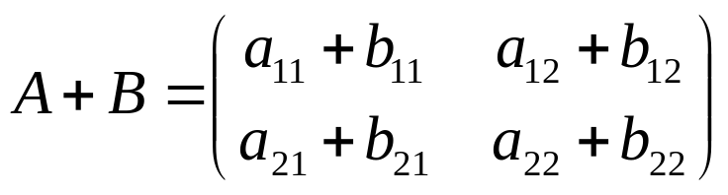
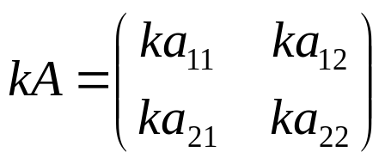
MATRICES
  Basic operations on matrix

Slide 13
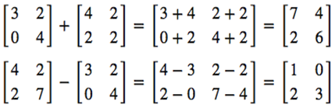

MATRICES
  Additive and subtraction:
  Scalar product (matrix-constant product)

Slide 14
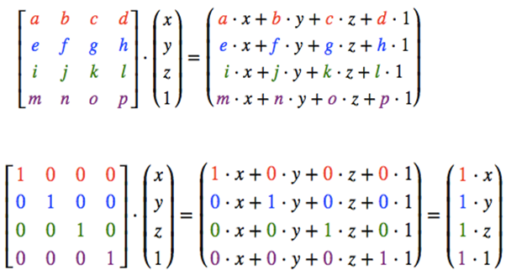
MATRICES
  Matrix -vector product:

Slide 15
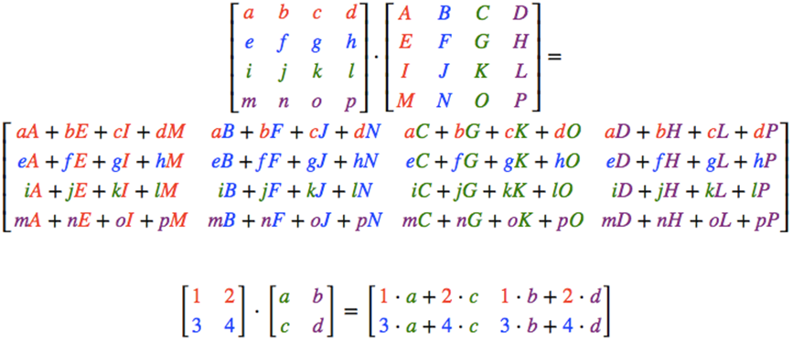
MATRICES
  Matrix -Matrix product:

Slide 16



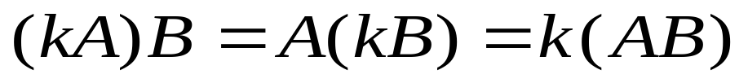
MATRIX MULTIPLICATION
Definition
Properties
  Not Commutative
  Associative
  Distributive
  Scalar Multiplication
j-th column
i-th row
m
(i,j)
l
×
=
l
m
n
n

Slide 17
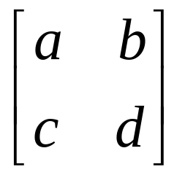
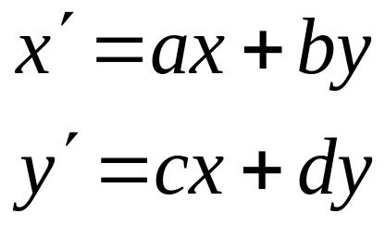
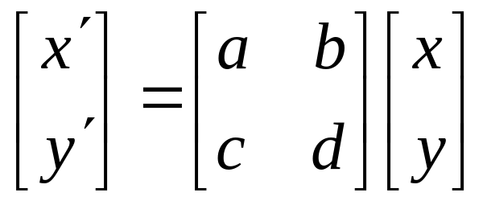
MATRIX REPRESENTATION
Represent a 2D Transformation by a Matrix
Apply the Transformation to a Point
Transformation
Matrix
Point

Slide 18
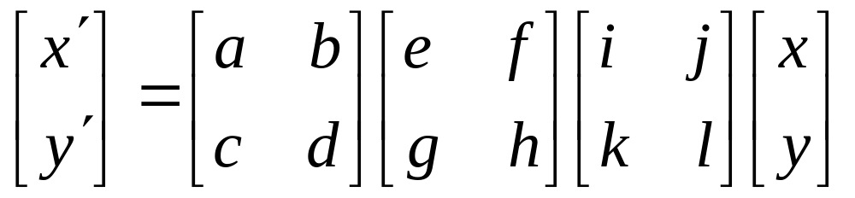
MATRIX REPRESENTATION
Transformations can be combined by matrix multiplication
Transformation
Matrix

Slide 19
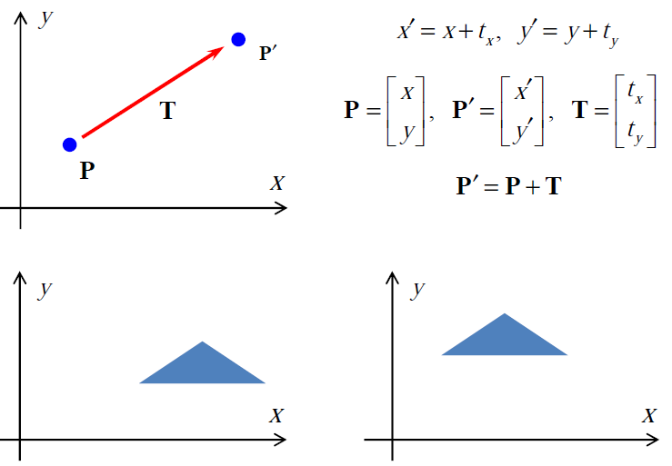
2D TRANSLATION

Slide 20
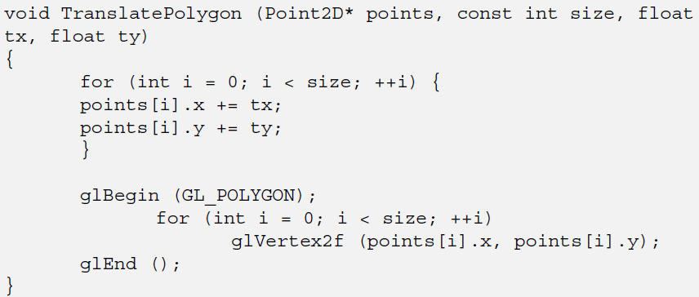
2D TRANSLATION

Slide 21
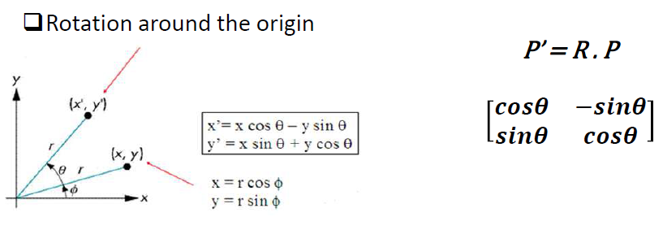
2D ROTATION

Slide 22
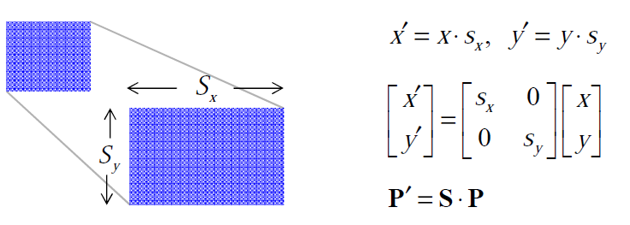
2D SCALING

Slide 23
HOMOGENOUS COORDINATE
Rotate and then displace a point P : P’ =M₁ . P +M₂
where M₁ is 2 x 2 rotation matrix, and M₂ is 2 x 1 translation vector.
Displacement is a non linear operation → we can make it linear with Homogeneous Coordinates
(x,y)→ (x,y,1)
Transformations turn into 3 x3 matrices.
Very big advantage. All transformations are concatenated by matrix multiplication.

Slide 24
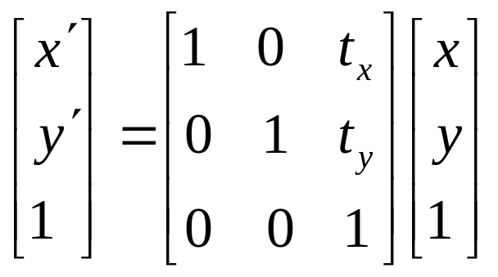
2D TRANSLATION
2D translation can be represented by a 3×3 matrix
(t_{x}, t_{y}) is called translation vector

Slide 25
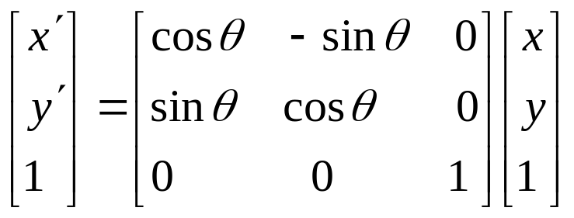
2D ROTATION

Slide 26
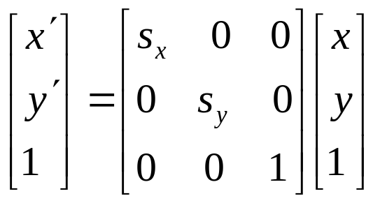

2D SCALING
(s_{x}, s_{y}) is called scaling factor

Slide 27
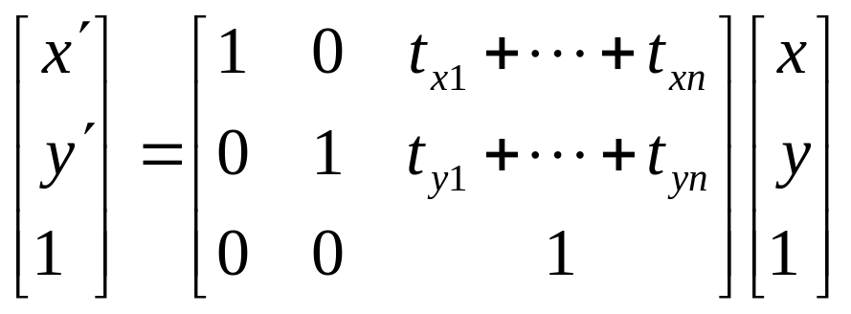
SUCCESSIVE TRANSFORMATIONS
2 or more successive translations are additive
(t_{x1}, t_{y1}), …, (t_{xn}, t_{yn})

Slide 28
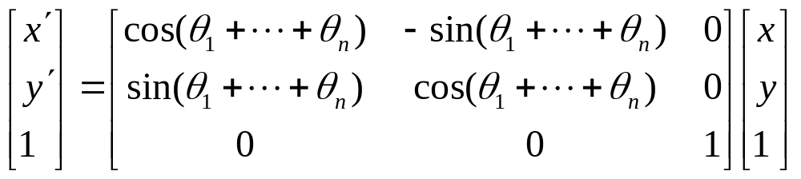
SUCCESSIVE TRANSFORMATIONS
2 or more successive rotations are additive
θ₁, …, θ_{n}

Slide 29
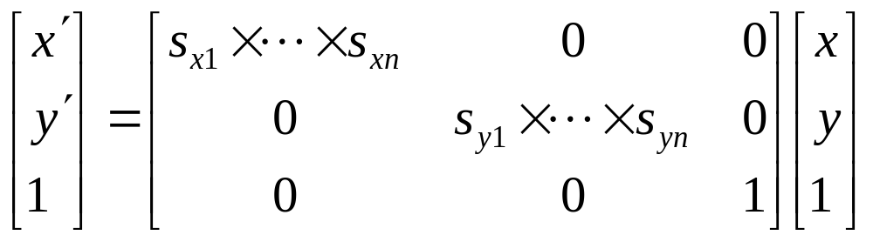
SUCCESSIVE TRANSFORMATIONS
2 or more successive scalings are multiplicative
(s_{x1}, s_{y1}), …, (s_{xn}, s_{yn})

Slide 30
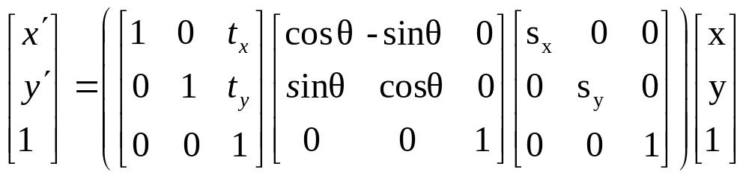



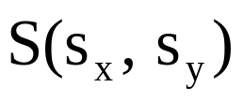

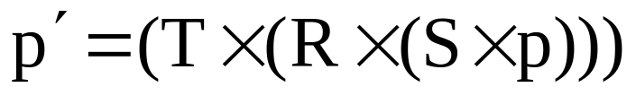
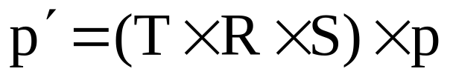
MATRIX COMPOSITION
Transformations can be combined by matrix multiplication
  Matrix multiplication is associative

Slide 31
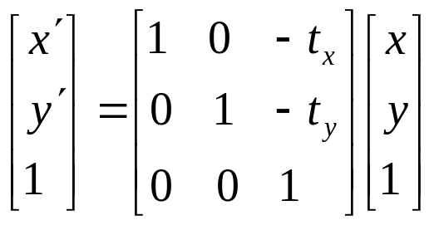
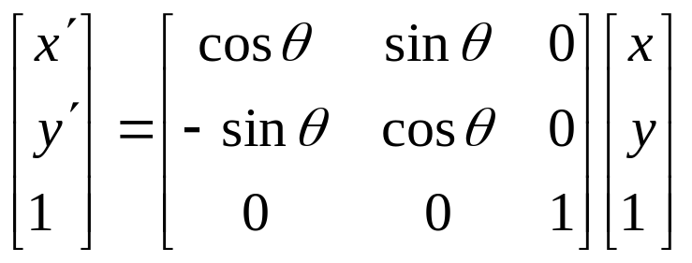
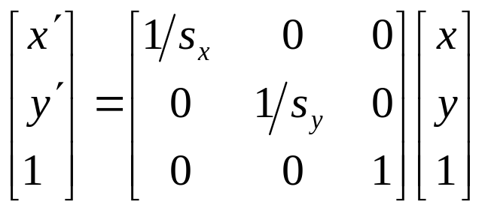
INVERSE TRANSFORMATIONS
Inverse Translation (T⁻¹):
Inverse Rotation (R⁻¹):
Inverse Scaling (S⁻¹):

Slide 32
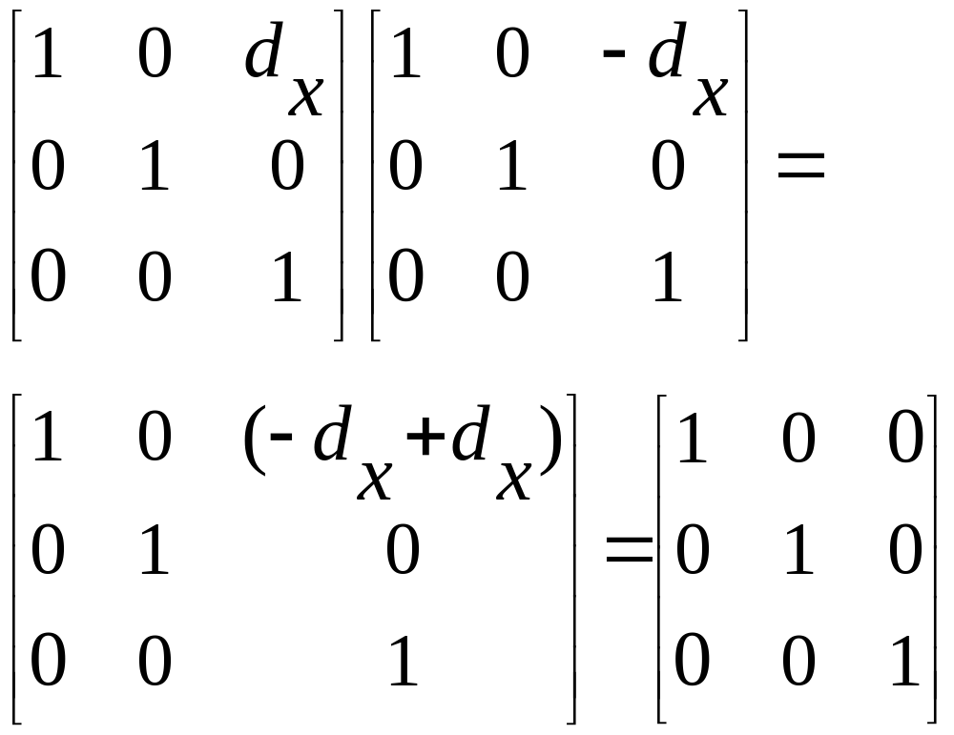
INVERSE TRANSLATION (T⁻¹)

Slide 33
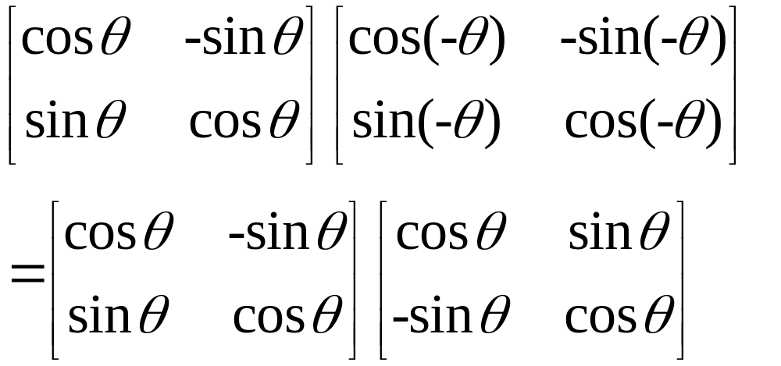
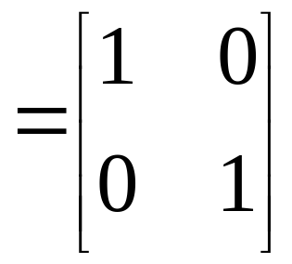
INVERSE ROTATION (R⁻¹)

Slide 34
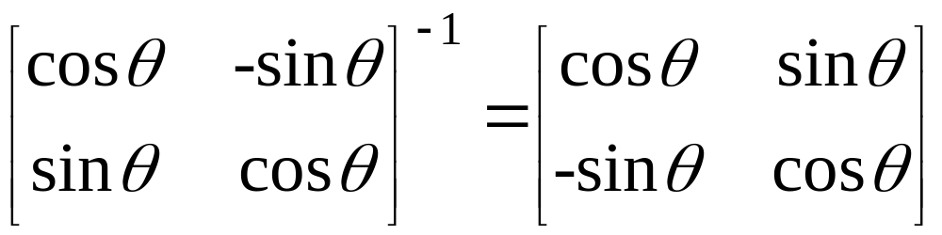
INVERSE ROTATION (R⁻¹)

Slide 35
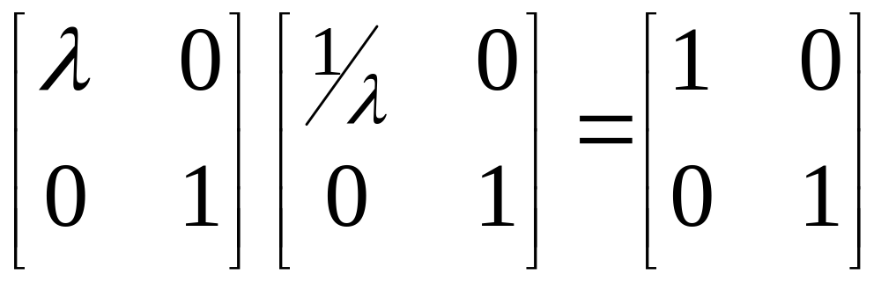
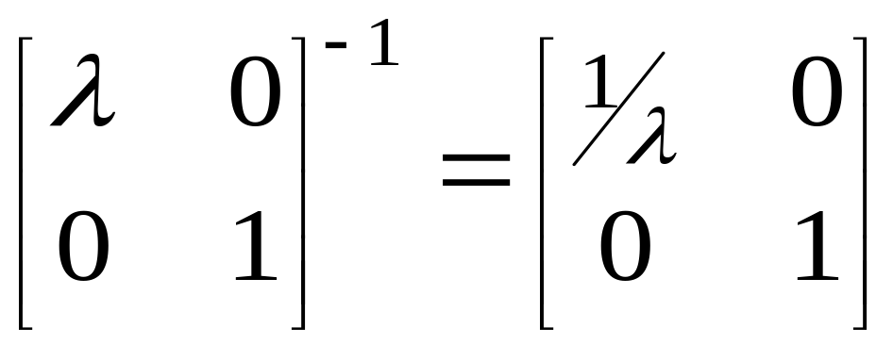
INVERSE SCALING (S⁻¹)

Slide 36
FIXED POINT TRANSFORMATION
Rotate by θ around fixed point (a,b)
Scale by s_{x}, s_{y} around fixed point (a,b)
(a,b)
(a,b)

Slide 37
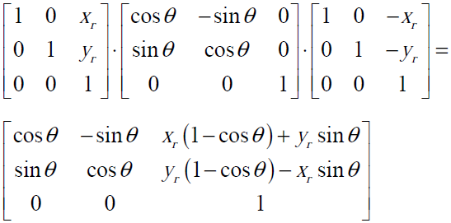
FIXED POINT ROTATION (X_{F}, Y_{F})
Inverse Translate
Rotate
Translate
(x_{f},y_{f})
(x_{f},y_{f})
(x_{f},y_{f})
(x_{f},y_{f})

Slide 38
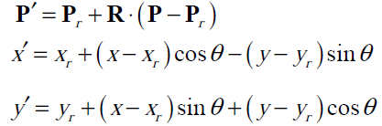
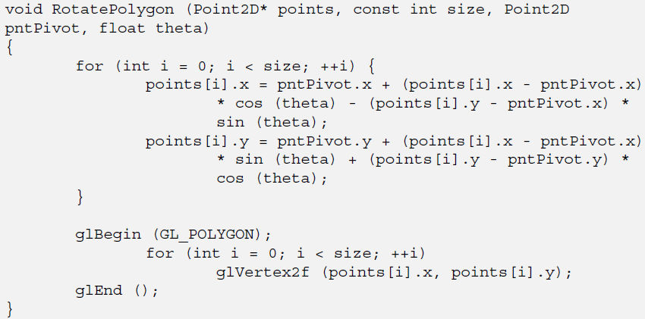
FIXED POINT ROTATION (X_{F}, Y_{F})

Slide 39
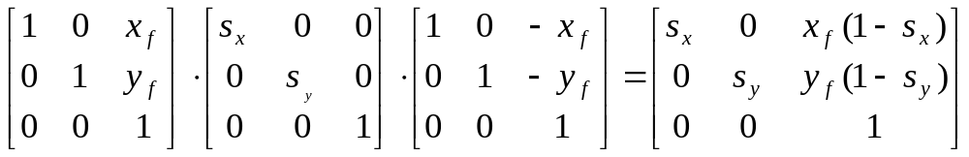
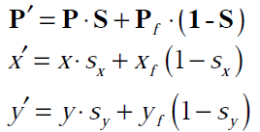
FIXED POINT SCALING(X_{F}, Y_{F})
Inverse Translate
Scale
Translate
(x_{f},y_{f})
(x_{f},y_{f})
(x_{f},y_{f})
(x_{f},y_{f})

Slide 40
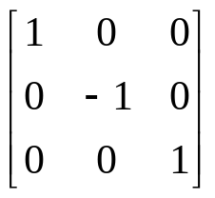
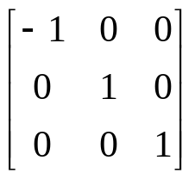
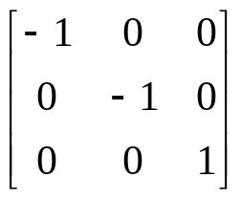
REFLECTION
Reflection with respect to the axis
About x-axis About y-axis About xy-plane
(line y = 0) (line x = 0)
y
1
y
y
1
1’
1’
2
3
2
3
3’
2
3’
2
x
x
3
x
2’
3’
1
1’
2

Slide 41

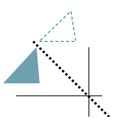

REFLECTION
Reflection with respect to a Line
y
line y=x
x
x
line y=-x

Slide 42
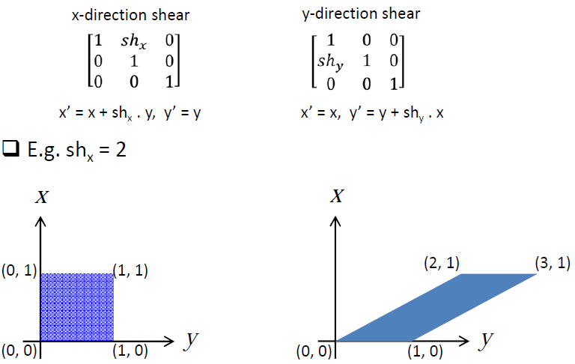
SHEARING
Shear: a transformation that distorts the shape of an object

Slide 43
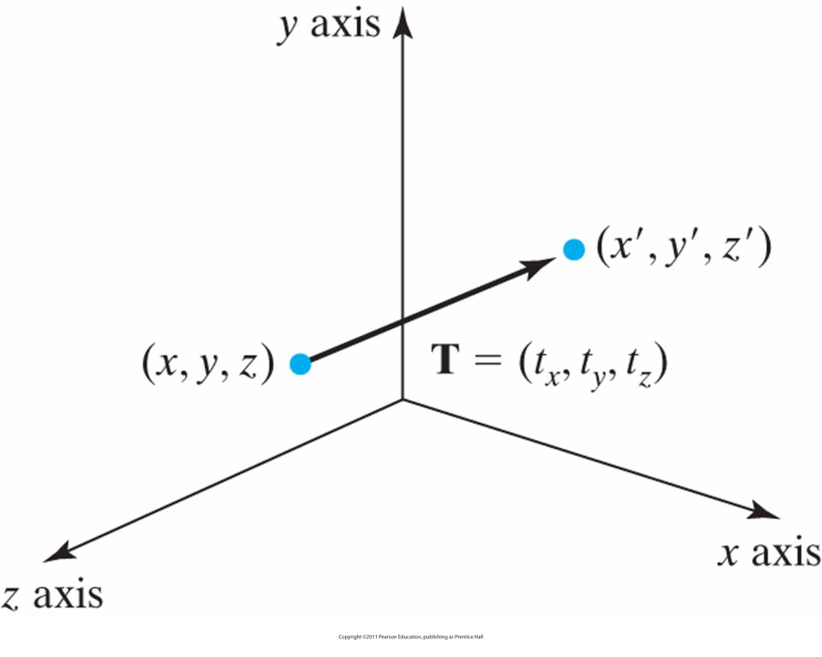

3D GEOMETRIC TRANSFORMATIONS

Slide 44


3D TRANSLATION
Translation of a Point
y
x
z

Slide 45


3D SCALING
About origin
y
x
z

Slide 46

3D SCALING ABOUT A FIXED POINT (X_{F}, Y_{F}, Z_{F})
y
y
y
y
z
x
z
x
z
x
z
x
Original position
Inverse Translate
Scaling
Translate

Slide 47
3D ROTATION
Coordinate-Axes Rotations
  X-axis rotation
  Y-axis rotation
  Z-axis rotation

Slide 48



COORDINATE-AXES ROTATIONS
Z-Axis Rotation
X-Axis Rotation
Y-Axis Rotation
y
y
y
x
x
x
z
z
z

Slide 49

ORDER OF ROTATIONS
Order of Rotation Affects Final Position
  X-axis ➔ Z-axis
  Z-axis ➔ X-axis

Slide 50

3D REFLECTION
Reflection relative to the xy plane
y
y
z
z
x
x

Slide 51

COMBINING 3D TRANSFORMATIONS

Slide 52

EXAMPLES

Slide 53

EXAMPLES

Slide 54

EXAMPLES

Slide 55

EXAMPLES

Slide 56

EXAMPLES

Slide 57

EXAMPLES

Slide 58
CODES
2D Full Example (Code)
https://open.gl/content/code/c4_transformation.txt
3D Full Example (Code)
https://open.gl/content/code/c4_3d.txt

Slide 59
End of Chapter

